Slide 1



Spreadsheet
Class VI
lab 24

Slide 2
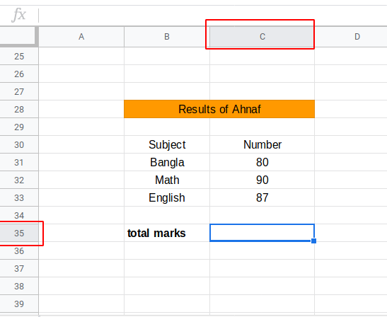
Demo Table
You need to add the
total marks from this
demo table

Slide 3
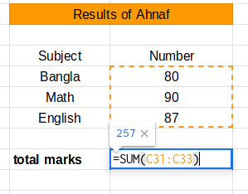
Addition
use “SUM” function and determine the
cell number for addition

Slide 4
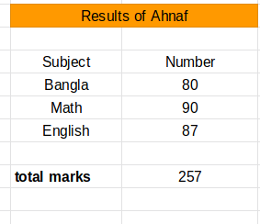
Addition (Results)
total marks = 257

Slide 5
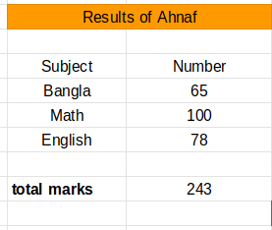
Addition (Results)
Every time you change the value of C31 to C33 the total marks will be changed automatically

Slide 6
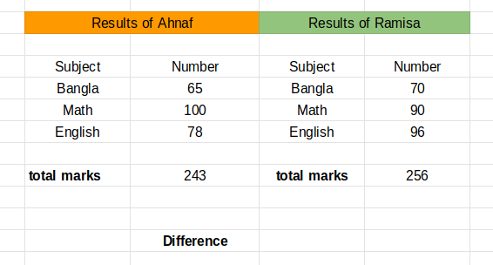
Subtraction
calculate the difference
from 256 to 243

Slide 7
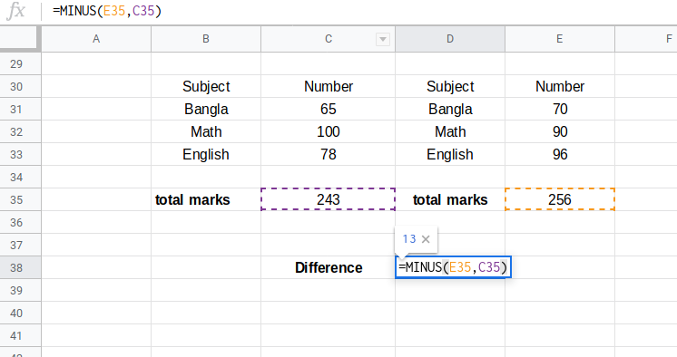
Subtraction
formula is
=MINUS(E35, C35)

Slide 8
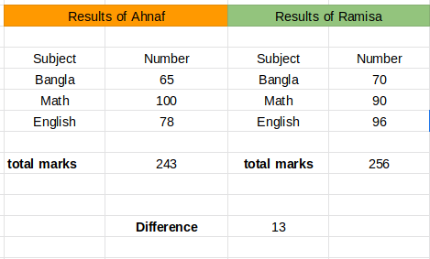
Subtraction Results
formula is
=MINUS(E35, C35)

Slide 9



